Slide 1


GitHub
Presented by Dr. Veronica McGowan

Slide 2
Git vs GitHub
Git-open-source tool for sharing code and working with coding versions; works on your local computer
GitHub –A free, public remote website where your project is permanently hosted; company that makes tools to integrate with Git; others GitLab, BitBucket and host-your-own solutions
To use:
Install Git
There are also a few ways to install Git on Windows. The most official build is available for download on the Git website. Just go to https://git-scm.com/download/win and the download will start automatically.
There are several ways to install Git on a Mac. The easiest is probably to install the Xcode Command Line Tools. On Mavericks (10.9) or above you can do this simply by trying to run git from the Terminal the very first time.
$ git --version
If you don’t have it installed already, it will prompt you to install it.
If you want a more up to date version, you can also install it via a binary installer. A macOS Git installer is maintained and available for download at the Git website, at https://git-scm.com/download/mac.

Slide 3
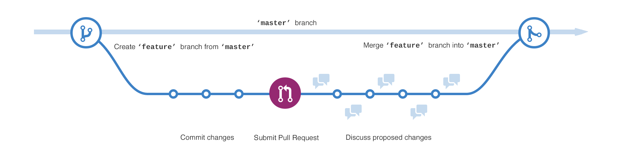
Vocab
Version Control
Repository
Clone Commit (the noun)
Commit (the verb)
Push Pull(=fetch)

Slide 4
Set up the repository on GitHub
go to your github site (https://github.com/MyGitHub)
log in to your github account (username, password)
create a new repository by clicking the “+” button
Name it (write down this name exactly)
use buttons to include a read me statement
initialize with a readme
do NOT add a gitignore
add a license (MIT is fine)

Slide 6
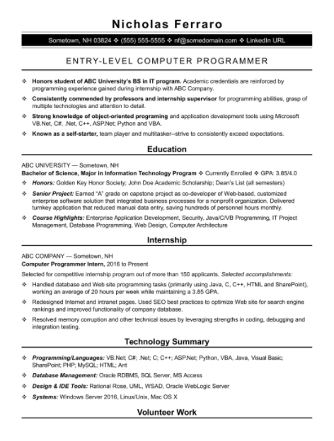
Resumes
Do include:
Contact information including field-based and general handles
Links to repositories
Links to projects
Format:
Bullets over sentences
Design important for some fields

Slide 7
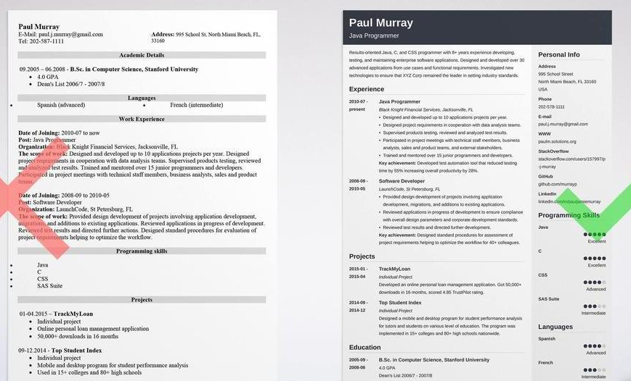

Slide 8
